Slide 1

Trading With ML: Classification and SVM

Slide 2

Support Vector Machine (Maximum Margin Classifier)
In a p dimensional space , a hyperplane is a flat subspace with dimension p-1.
Our aim is to maximize the margin to get an optimal line.
Maximum margin line is only useful when the data is linearly seperable.

Slide 3
Support Vector Machine (Maximum Margin Classifier)
If line is not helpful then use
Quadratic func.
Qubic func.
Higher order polynomial etc.
Kernel

Slide 4
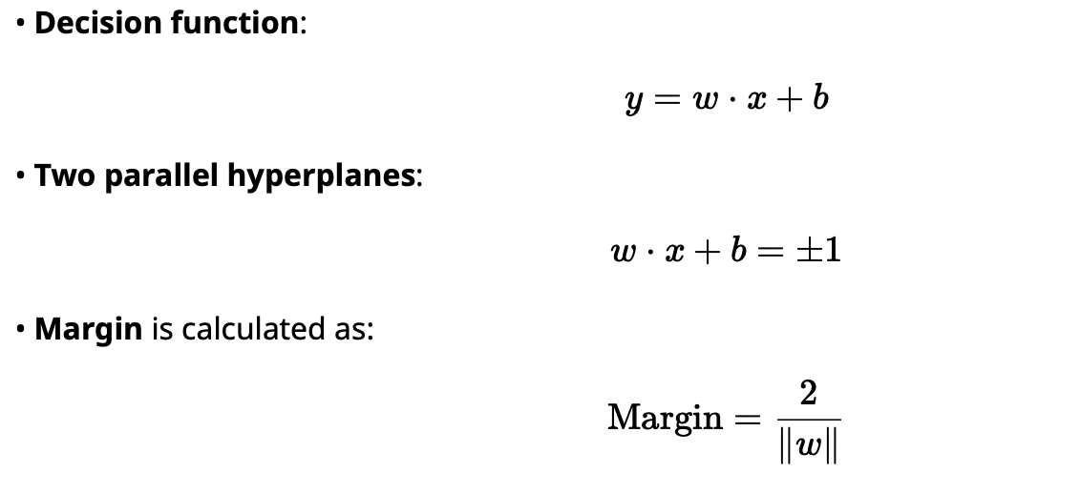
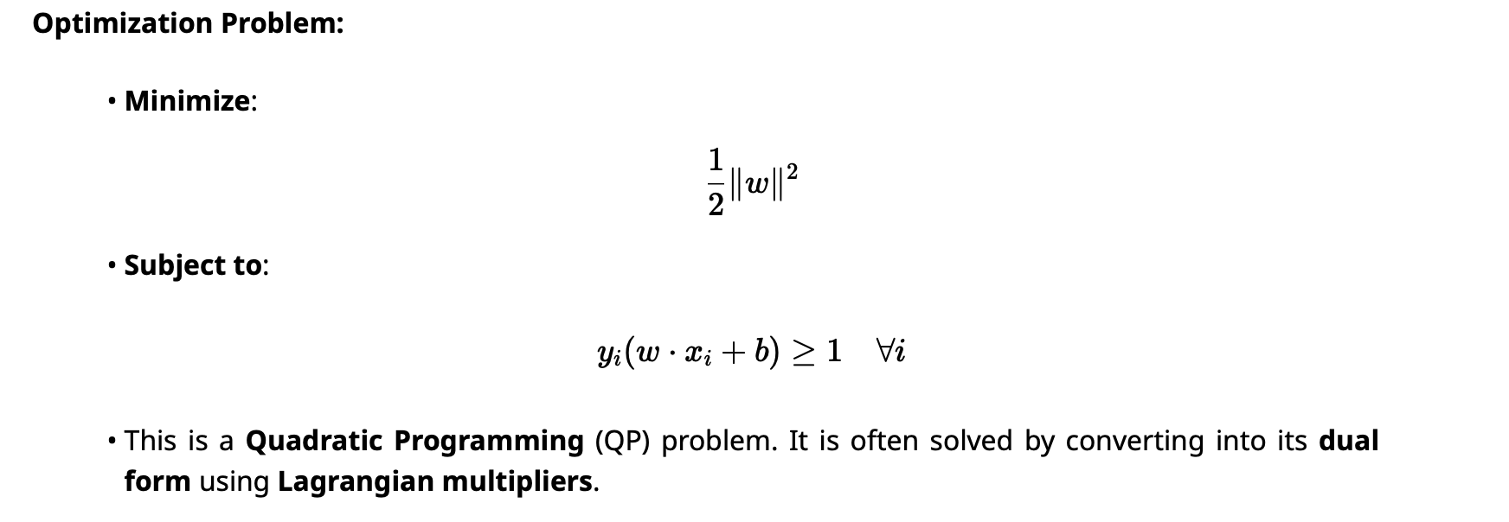
1. Hard Margin SVM (Linearly Separable Data)
SVM attempts to maximize the margin between two classes.

Slide 5
2. Support Vectors
Support vectors are the closest data points to the margin.
Only data points with non-zero Lagrangian multipliers contribute to defining the optimal hyperplane.
Other points do not affect the decision boundary.

Slide 6

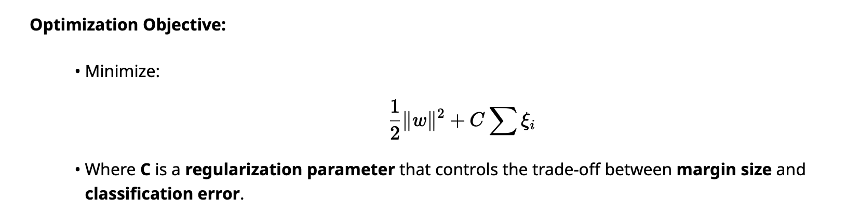
3. Soft Margin SVM (Non-Separable Data)
For noisy or overlapping data, Soft Margin SVM allows some misclassification.
Introduces slack variables ξi to relax margin constraints:

Slide 7
4. Non-linear SVM (Kernel Trick)
When data is not linearly separable, use a kernel function to project data into a higher- dimensional space:
K (xi , xj ) = φ(xi ) ⋅ φ(xj ) This allows the algorithm to create non-linear decision boundaries without explicitly computing φ(x) .
Common Kernel Functions:
• Linear: K(x, y) = x ⋅ y • Polynomial: K(x, y) = (x ⋅ y + c)d • RBF/Gaussian: K(x, y) = exp(−γ∥x − y∥2) • Sigmoid: K(x, y) = tanh(αx ⋅ y + β)

Slide 8
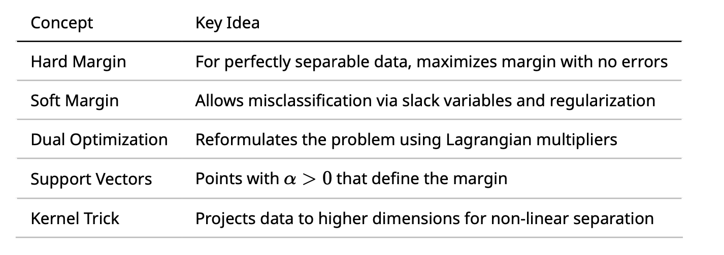
Summary

Slide 9
Kernel
Function that quatifies the similarity between two observations.
Mapping from low dimensional space to high dimesional space. (Kernel Trick)
Types of Kernel:
Linear Kernel
Polynomial Kernel
Sigmoid Kernel
Gaussian or RBF Kernel

Slide 10
C Parameter
Tradeoff between classification of training points and smooth decision boundary.
Large c: more support vectors
Small c: less support vectors
Very large c: overfitting
Very small c:underfitting

Slide 11
Gamma
How far the influence of a single training example reaches.
Verry large gamma: overfitting
Very small gamma:underfitting

